Slide 1


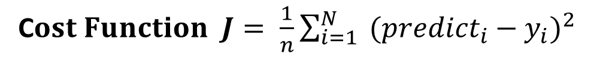
Linear Regression 線性迴歸
Regression is a method of modelling a target value based on independent predictors. This method is mostly used for forecasting and finding out cause and effect relationship between variables.
Regression techniques mostly differ based on the number of independent variables and the type of relationship between the independent and dependent variables.
Simple Linear Regression is a type of regression analysis where the number of independent variables is one and there is a linear relationship between the independent(x) and dependent(y) variable.
$$y=f(x)$$
C$ost Function J= \frac{1}{n}\sum_{i=1}^{N}{{ ({predict}_{i}−y_{i})}^{2 }}$
$$minimize J$$

Slide 2
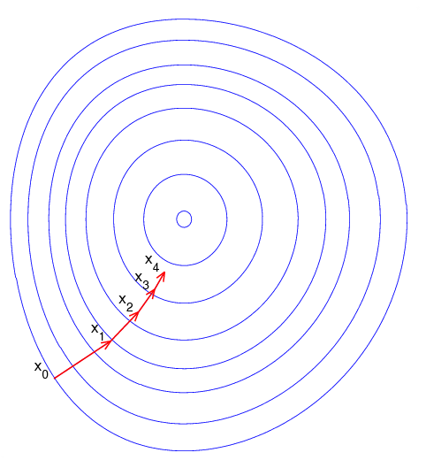
Gradient Decent 梯度下降法
"A gradient measures how much the output of a function changes if you change the inputs a little bit." — Lex Fridman (MIT)
Gradient Descent is an optimization algorithm for finding a local minimum of a differentiable function.
Gradient descent in machine learning is simply used to find the values of a function's parameters (coefficients) that minimize a cost function as far as possible.
Image: Niklas Donges

Slide 3
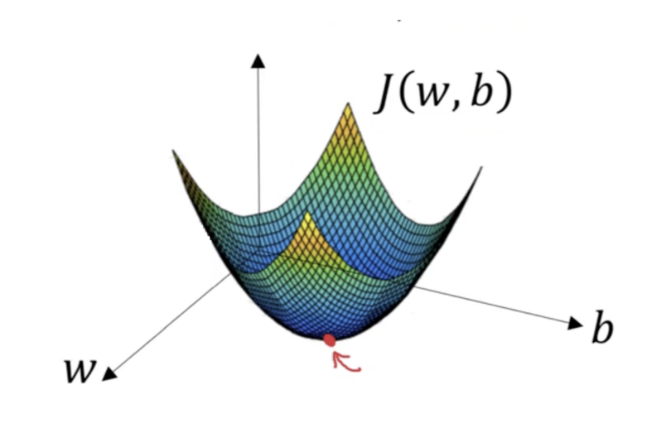
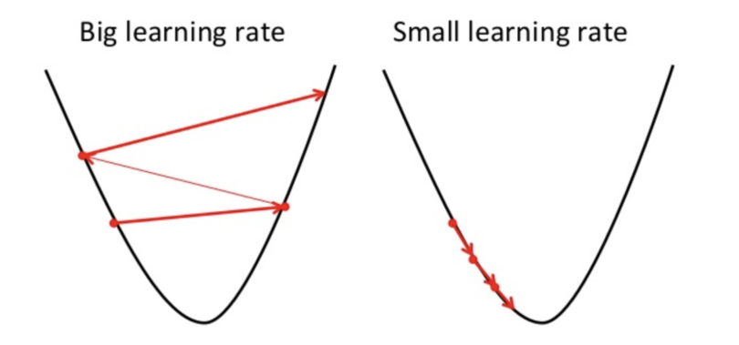


How Gradient Descent Works
Gradient descent is a convex function
For the gradient descent algorithm to reach the local minimum we must set the learning rate to an appropriate value, which is neither too low nor too high.
$$a_{n+1}=a_{n}−γ∇F(a_{n})$$
$$γ$$
Image: Niklas Donges

Slide 4
Types of Gradient Descent
Batch Gradient Decent
Batch gradient descent, also called vanilla gradient descent, calculates the error for each example within the training dataset, but only after all training examples have been evaluated does the model get updated. This whole process is like a cycle and it’s called a training epoch.
Stochastic Gradient Decent
Stochastic gradient descent (SGD) does this for each training example within the dataset, meaning it updates the parameters for each training example one by one. Depending on the problem, this can make SGD faster than batch gradient descent. One advantage is the frequent updates allow us to have a pretty detailed rate of improvement.
Mini-Batch Gradient Decent
Mini-batch gradient descent is the go-to method since it’s a combination of the concepts of SGD and batch gradient descent. It simply splits the training dataset into small batches and performs an update for each of those batches. This creates a balance between the robustness of stochastic gradient descent and the efficiency of batch gradient descent.

Slide 5
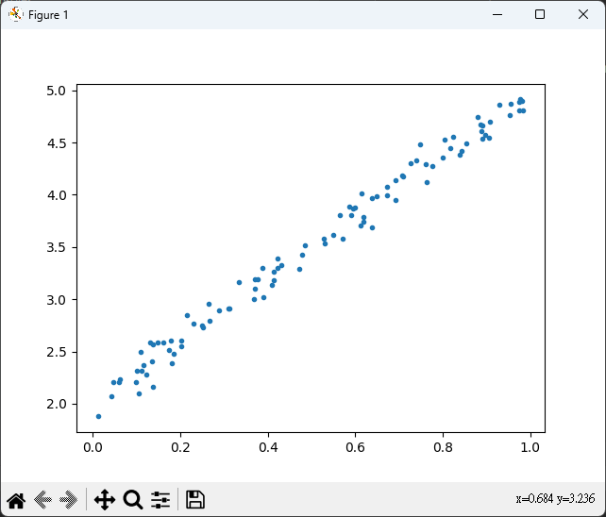
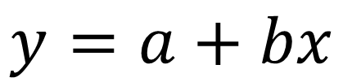
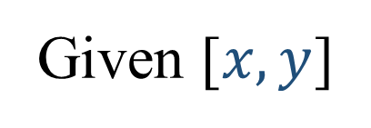
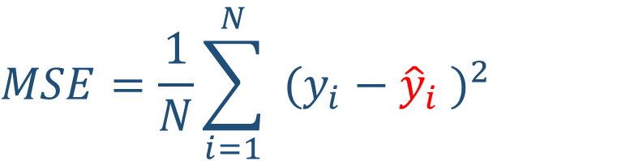

A Simple Regression Example 線性迴歸
Given [$x, y$]
[x₁, y₁]
[x₂, y₂]
[x₃, y₃]
[x₄, y₄]
[x₁, y₁]
…
[x_{N}, y_{N}]
$$y=a+bx$$
$$Find a, b that minimize$$
$$MSE=\frac{1}{N}\sum_{i=1}^{N}{{ ({y_{i}−\hat{y}}_{i} )}^{2 }}$$

Slide 6
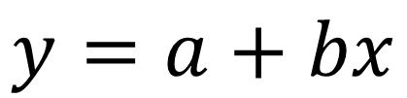
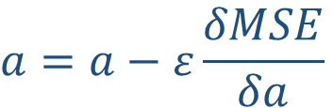





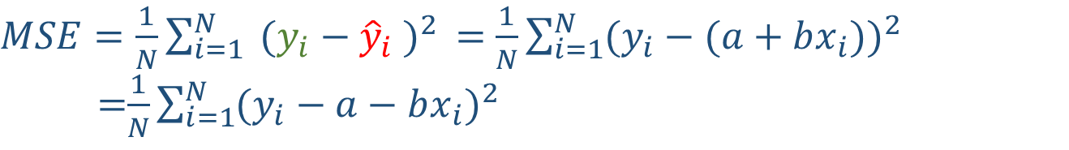


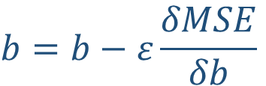
$$1$$
$$a$$
$$y=a+bx$$
$$\hat{y}$$
$$y$$
Given [$x, y$]
$$x$$
$$b$$
x y
[4.76e-01, 3.53e+00],
[1.02e-01, 2.33e+00],
[7.49e-01, 4.17e+00],
[6.43e-01, 4.08e+00],
[1.30e-02, 1.87e+00],
[8.82e-01, 4.59e+00],
[8.57e-01, 4.49e+00],
[4.11e-01, 3.22e+00],
[4.50e-01, 3.19e+00],
[4.41e-01, 3.30e+00],
[4.56e-01, 3.30e+00],
[1.11e-01, 2.39e+00],
[9.31e-01, 4.93e+00],
…
$MSE=\frac{1}{N}\sum_{i=1}^{N}{{ ({y_{i}−\hat{y}}_{i} )}^{2 }}=$ $\frac{1}{N}\sum_{i=1}^{N}{{(y_{i}−(a+bx_{i}))}^{2}}$
=$\frac{1}{N}\sum_{i=1}^{N}{{(y_{i}−a−bx_{i})}^{2}}$
$\frac{δMSE}{δa}=\frac{δMSE}{δ{\hat{y}}_{i}}∙\frac{δ{\hat{y}}_{i}}{δa}=$ $\frac{1}{N}\sum_{i=1}^{N}{2\left(y_{i}−a−bx_{i}\right)\left(−1\right)}=\frac{−2}{N}\sum_{i=1}^{N}{({y_{i}−\hat{y}}_{i}) }$
$\frac{δMSE}{δb}=\frac{δMSE}{δ{\hat{y}}_{i}}∙\frac{δ{\hat{y}}_{i}}{δb}=$ $\frac{1}{N}\sum_{i=1}^{N}{2\left(y_{i}−a−bx_{i}\right)\left(−x_{i}\right)}=\frac{−2}{N}\sum_{i=1}^{N}{x_{i}({y_{i}−\hat{y}}_{i}) }$
$$a=a−ε\frac{δMSE}{δa}$$
$$b=b−ε\frac{δMSE}{δb}$$
Gradient Descent
a small value: learning rate

Slide 7

$$Learning from Sctatch$$

Slide 8
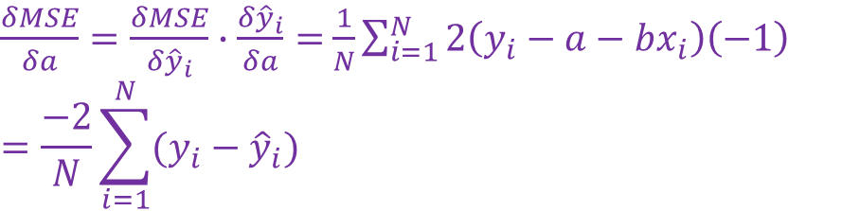
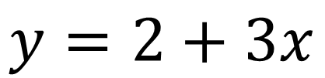
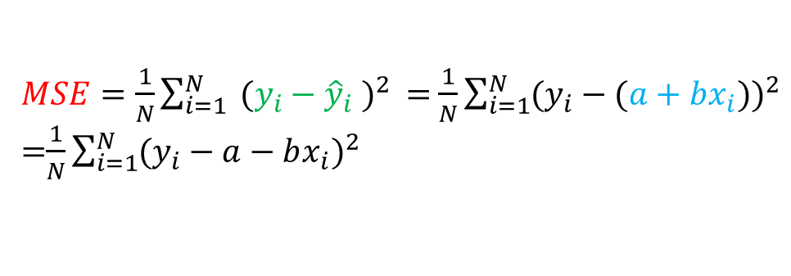


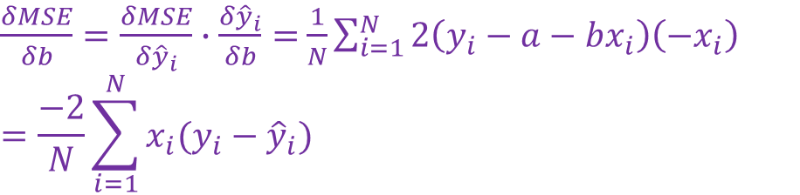
$$y=2+3x$$
import numpy as np
np.random.seed(123)
n_train = 100
x_train = np.random.rand(n_train, 1)
y_train = 2 + 3 * x_train + .1 * np.random.randn(n_train, 1)
a = np.random.randn(1)
b = np.random.randn(1)
print(a, b)
lr = 1e-1
n_epochs = 1000
for epoch in range(n_epochs):
yhat = a + b * x_train
error = (y_train - yhat)
loss = (error ** 2).mean()
a_grad = -2 * error.mean()
b_grad = -2 * (x_train * error).mean()
a = a - lr * a_grad
b = b - lr * b_grad
print(a, b)
$MSE=\frac{1}{N}\sum_{i=1}^{N}{{ ({y_{i}−\hat{y}}_{i} )}^{2 }}=$ $\frac{1}{N}\sum_{i=1}^{N}{{(y_{i}−(a+bx_{i}))}^{2}}$ =$\frac{1}{N}\sum_{i=1}^{N}{{(y_{i}−a−bx_{i})}^{2}}$
$\frac{δMSE}{δa}=\frac{δMSE}{δ{\hat{y}}_{i}}∙\frac{δ{\hat{y}}_{i}}{δa}=$ $\frac{1}{N}\sum_{i=1}^{N}{2\left(y_{i}−a−bx_{i}\right)\left(−1\right)}$
$$=\frac{−2}{N}\sum_{i=1}^{N}{({y_{i}−\hat{y}}_{i}) }$$
$\frac{δMSE}{δb}=\frac{δMSE}{δ{\hat{y}}_{i}}∙\frac{δ{\hat{y}}_{i}}{δb}=$ $\frac{1}{N}\sum_{i=1}^{N}{2\left(y_{i}−a−bx_{i}\right)\left(−x_{i}\right)}$
$$=\frac{−2}{N}\sum_{i=1}^{N}{x_{i}({y_{i}−\hat{y}}_{i}) }$$
$$a=a−ε\frac{δMSE}{δa}$$
$$b=b−ε\frac{δMSE}{δb}$$
[-0.35482446] [0.39158424]
[2.01703298] [2.97302273]

Slide 9

$$Learning by Pytorch$$
Autograd
Optimizer
Loss
Model
PyTorch’s Linear model
Dataset
DataLoader
Random Split
Evaluation

Slide 10
import torch
n_data = 100
x_train = torch.rand(n_data , 1)
y_train = 2 + 3 * x_train + .1 * torch.randn(n_data , 1)
device = 'cuda' if torch.cuda.is_available() else 'cpu'
x_train.to(device)
y_train.to(device)
a = torch.randn(1, requires_grad=True, dtype=torch.float, device=device)
b = torch.randn(1, requires_grad=True, dtype=torch.float, device=device)
lr = 1e-1
n_epochs = 1000
for epoch in range(n_epochs):
yhat = a + b * x_train
error = y_train - yhat
loss = (error ** 2).mean()
loss.backward()
with torch.no_grad():
a -= lr * a.grad
b -= lr * b.grad
a.grad.zero_()
b.grad.zero_()
print(a, b)
import torch
import torch.optim as optim
import torch.nn as nn
n_data = 100
x_train = torch.rand(n_data , 1)
y_train = 2 + 3 * x_train + .1 * torch.randn(n_data , 1)
device = 'cuda' if torch.cuda.is_available() else 'cpu'
x_train.to(device)
y_train.to(device)
a = torch.randn(1, requires_grad=True, dtype=torch.float, device=device)
b = torch.randn(1, requires_grad=True, dtype=torch.float, device=device)
lr = 1e-1
n_epochs = 1000
optimizer = optim.SGD([a, b], lr=lr)
loss_fn = nn.MSELoss(reduction='mean')
for epoch in range(n_epochs):
yhat = a + b * x_train
loss = loss_fn(y_train, yhat)
loss.backward()
optimizer.step()
optimizer.zero_grad()
print(a, b)
Optimizer
Loss
Autograd
tensor([1.9493], requires_grad=True) tensor([3.0931], requires_grad=True)
tensor([1.9653], requires_grad=True) tensor([3.0438], requires_grad=True)

Slide 11




import torch
import torch.optim as optim
import torch.nn as nn
class ManualLinearRegression(nn.Module):
def __init__(self):
super().__init__()
self.a = nn.Parameter(torch.randn(1, requires_grad=True, dtype=torch.float))
self.b = nn.Parameter(torch.randn(1, requires_grad=True, dtype=torch.float))
def forward(self, x):
# Computes the outputs / predictions
return self.a + self.b * x
n_data = 100
x_train = torch.rand(n_data, 1)
y_train = 2 + 3 * x_train + .1 * torch.randn(n_data, 1)
device = 'cuda' if torch.cuda.is_available() else 'cpu'
x_train.to(device)
y_train.to(device)
model = ManualLinearRegression().to(device)
# We can also inspect its parameters using its state_dict
print(model.state_dict())
lr = 1e-1
n_epochs = 1000
loss_fn = nn.MSELoss(reduction='mean')
optimizer = optim.SGD(model.parameters(), lr=lr)
for epoch in range(n_epochs):
model.train()
yhat = model(x_train)
loss = loss_fn(y_train, yhat)
loss.backward()
optimizer.step()
optimizer.zero_grad()
print(model.state_dict())
import torch
import torch.optim as optim
import torch.nn as nn
class LayerLinearRegression(nn.Module):
def __init__(self):
super().__init__()
# Instead of our custom parameters, we use a Linear layer with single input and single output
self.linear = nn.Linear(1, 1, bias=2)
def forward(self, x):
# Now it only takes a call to the layer to make predictions
return self.linear(x)
n_data = 100
x_train = torch.rand(n_data , 1)
y_train = 2 + 3 * x_train + .1 * torch.randn(n_data , 1)
device = 'cuda' if torch.cuda.is_available() else 'cpu'
x_train.to(device)
y_train.to(device)
model = LayerLinearRegression().to(device)
# We can also inspect its parameters using its state_dict
print(model.state_dict())
lr = 1e-1
n_epochs = 1000
loss_fn = nn.MSELoss(reduction='mean')
optimizer = optim.SGD(model.parameters(), lr=lr)
for epoch in range(n_epochs):
model.train()
yhat = model(x_train)
loss = loss_fn(y_train, yhat)
loss.backward()
optimizer.step()
optimizer.zero_grad()
print(model.state_dict())
$$w_{1}$$
$$x_{1}$$
$$y_{1}$$
Model
$$bias$$
OrderedDict([('a', tensor([-0.3904])), ('b', tensor([-0.7202]))])
OrderedDict([('a', tensor([2.0275])), ('b', tensor([2.9945]))])
OrderedDict([('linear.weight', tensor([[0.6458]])), ('linear.bias', tensor([0.0704]))])
OrderedDict([('linear.weight', tensor([[2.9943]])), ('linear.bias', tensor([2.0173]))])

Slide 12
import torch
import torch.optim as optim
import torch.nn as nn
class LayerLinearRegression(nn.Module):
def __init__(self):
super().__init__()
self.linear = nn.Linear(1, 1, bias=2)
def forward(self, x):
# Now it only takes a call to the layer to make predictions
return self.linear(x)
def make_train_step(model, loss_fn, optimizer):
# Builds function that performs a step in the train loop
def train_step(x, y):
model.train()
yhat = model(x)
loss = loss_fn(y, yhat)
loss.backward()
optimizer.step()
optimizer.zero_grad()
return loss.item()
# Returns the function that will be called inside the train loop
return train_step
n_data = 100
x_train = torch.rand(n_data, 1)
y_train = 2 + 3 * x_train + .1 * torch.randn(n_data, 1)
device = 'cuda' if torch.cuda.is_available() else 'cpu'
x_train.to(device)
y_train.to(device)
model = LayerLinearRegression().to(device)
# We can also inspect its parameters using its state_dict
print(model.state_dict())
lr = 1e-1
n_epochs = 1000
loss_fn = nn.MSELoss(reduction='mean')
optimizer = optim.SGD(model.parameters(), lr=lr)
# Creates the train_step function for our model, loss function and optimizer
train_step = make_train_step(model, loss_fn, optimizer)
losses = []
for epoch in range(n_epochs):
loss = train_step(x_train, y_train)
losses.append(loss)
print(model.state_dict())
OrderedDict([('linear.weight', tensor([[-0.6890]])), ('linear.bias', tensor([-0.7015]))])
OrderedDict([('linear.weight', tensor([[2.9613]])), ('linear.bias', tensor([2.0182]))])

Slide 13

$$Data Generation$$

Slide 14


$$Data Generation$$
$$y=2+3x+ε$$
import numpy as np
import matplotlib.pyplot as plt
# Data Generation
np.random.seed(1411)
x = np.random.rand(100, 1)
y = 2 + 3 * x + .1 * np.random.randn(100, 1)
# plot the data
plt.plot(x, y, '.')
plt.show()

Slide 15
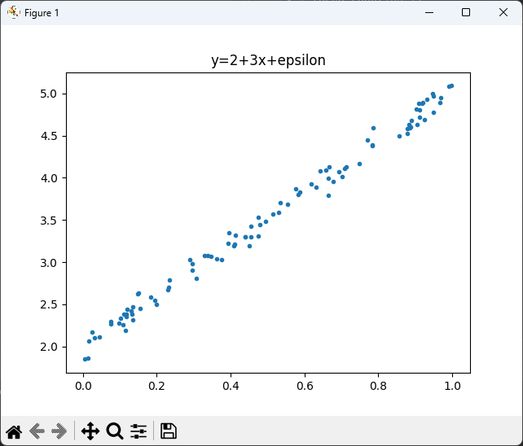
$$Data Generation$$
$$y=2+3x+ε$$
import torch
import matplotlib.pyplot as plt
# Data Generation
torch.manual_seed(1411)
x = torch.rand(100,1)
y = 2 + 3 * x + .1 * torch.randn(100, 1)
# plot the data
plt.title('y=2+3x+epsilon')
plt.plot(x.numpy(), y.numpy(), '.')
plt.show()

Slide 16

$$x y$$
$$Data Generation$$
tensor([[4.76e-01, 3.53e+00],
[1.02e-01, 2.33e+00],
[7.49e-01, 4.17e+00],
[6.43e-01, 4.08e+00],
[1.30e-02, 1.87e+00],
[8.82e-01, 4.59e+00],
[8.57e-01, 4.49e+00],
[4.11e-01, 3.22e+00],
[4.50e-01, 3.19e+00],
[4.41e-01, 3.30e+00],
[4.56e-01, 3.30e+00],
[1.11e-01, 2.39e+00],
[9.31e-01, 4.93e+00],
[3.07e-01, 2.81e+00],
[6.94e-01, 4.07e+00],
[2.96e-01, 2.98e+00],
[2.55e-02, 2.18e+00],
[6.33e-01, 3.89e+00],
[6.66e-01, 4.13e+00],
…
$$y=2+3x+ε$$
import torch
import matplotlib.pyplot as plt
# Data Generation
torch.manual_seed(1411)
x = torch.rand(100,1)
y = 2 + 3 * x + .1 * torch.randn(100, 1)
torch.set_printoptions(precision=2)
z = torch.cat([x,y], dim=1)
print(z)

Slide 17
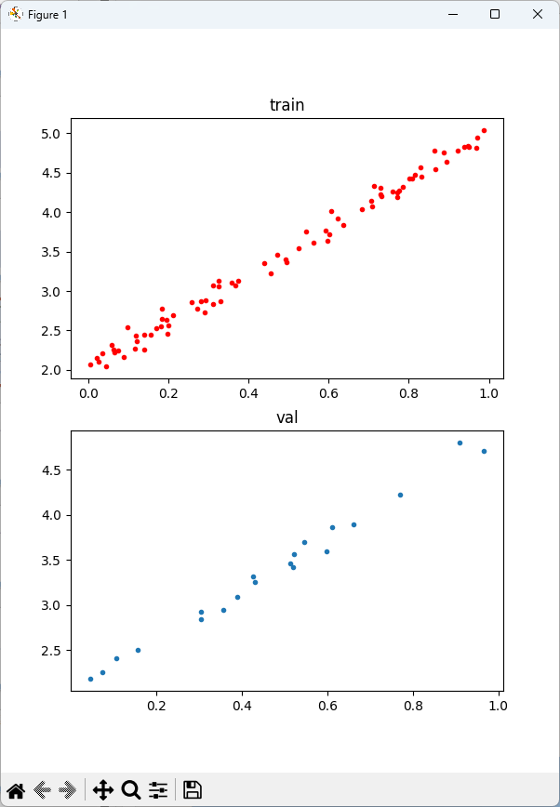


import numpy as np
import matplotlib.pyplot as plt
Import torch
# Data Generation
np.random.seed(42)
x = np.random.rand(100, 1)
y = 2 + 3 * x + .1 * np.random.randn(100, 1)
# Shuffles the indices
idx = np.arange(100)
np.random.shuffle(idx)
# Uses first 80 random indices for train
train_idx = idx[:80]
# Uses the remaining indices for validation
val_idx = idx[80:]
# Generates train and validation sets
x_train, y_train = x[train_idx], y[train_idx]
x_val, y_val = x[val_idx], y[val_idx]
# plot the data
fig = plt.figure(figsize=(6,8))
plt.subplot(2,1,1, title='train')
plt.plot(x_train, y_train, '.r')
plt.subplot(2,1,2, title='val')
plt.plot(x_val, y_val, '.')
plt.show()
$$Data$$
$$Generation$$
$$y=2+3x+ε$$

Slide 18

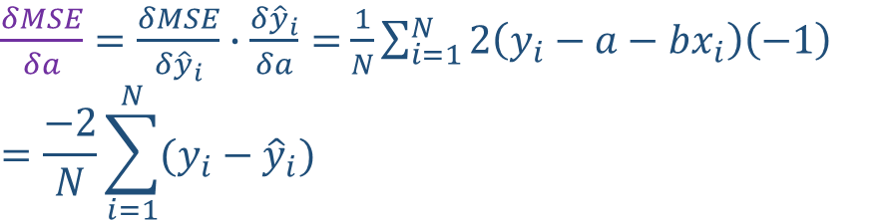
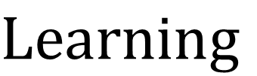
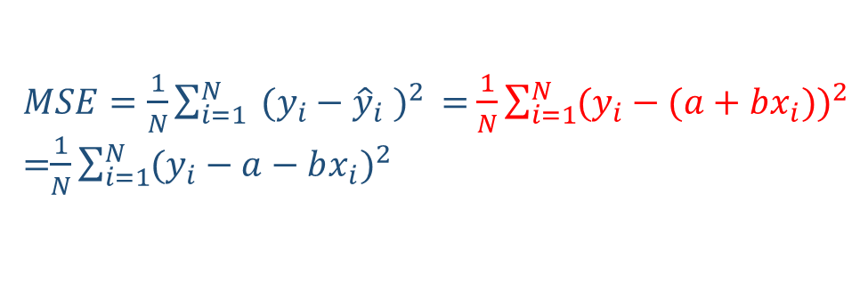




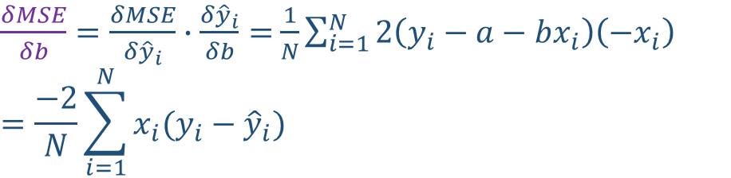

$$Learning$$
device = 'cuda' if torch.cuda.is_available() else 'cpu'
x_train_tensor = torch.from_numpy(x_train).float().to(device)
y_train_tensor = torch.from_numpy(y_train).float().to(device)
lr = 1e-1
n_epochs = 1000
torch.manual_seed(1411)
a = torch.randn(1, requires_grad=True, dtype=torch.float, device=device)
b = torch.randn(1, requires_grad=True, dtype=torch.float, device=device)
for epoch in range(n_epochs):
yhat = a + b * x_train_tensor
error = y_train_tensor - yhat
loss = (error ** 2).mean()
loss.backward()
print(a.grad)
print(b.grad)
with torch.no_grad():
a -= lr * a.grad
b -= lr * b.grad
a.grad.zero_()
b.grad.zero_()
print(a, b)
$MSE=\frac{1}{N}\sum_{i=1}^{N}{{ ({y_{i}−\hat{y}}_{i} )}^{2 }}=$ $\frac{1}{N}\sum_{i=1}^{N}{{(y_{i}−(a+bx_{i}))}^{2}}$ =$\frac{1}{N}\sum_{i=1}^{N}{{(y_{i}−a−bx_{i})}^{2}}$
$\frac{δMSE}{δa}=\frac{δMSE}{δ{\hat{y}}_{i}}∙\frac{δ{\hat{y}}_{i}}{δa}=$ $\frac{1}{N}\sum_{i=1}^{N}{2\left(y_{i}−a−bx_{i}\right)\left(−1\right)}$
$$=\frac{−2}{N}\sum_{i=1}^{N}{({y_{i}−\hat{y}}_{i}) }$$
$\frac{δMSE}{δb}=\frac{δMSE}{δ{\hat{y}}_{i}}∙\frac{δ{\hat{y}}_{i}}{δb}=$ $\frac{1}{N}\sum_{i=1}^{N}{2\left(y_{i}−a−bx_{i}\right)\left(−x_{i}\right)}$
$$=\frac{−2}{N}\sum_{i=1}^{N}{x_{i}({y_{i}−\hat{y}}_{i}) }$$
$$a$$
$$\hat{y}$$
$$y$$
$$a=a−ε\frac{δMSE}{δa}$$
$$b=b−ε\frac{δMSE}{δb}$$
$$b$$

Slide 19
Generalization

Slide 20
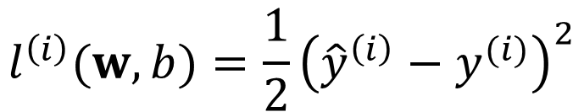
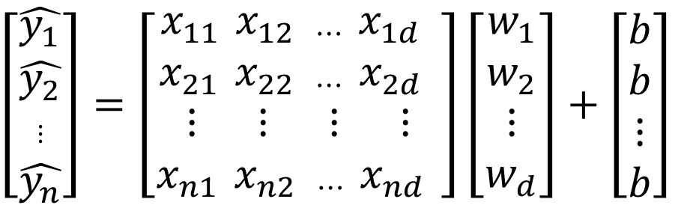


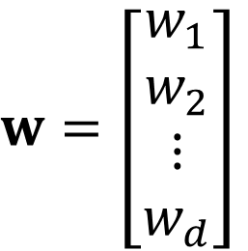
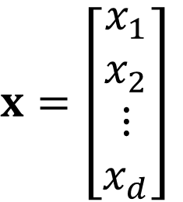

$$x=\left[\begin{aligned}x_{1} \\ x_{2} \\ ⋮ \\ x_{d}\end{aligned}\right]$$
$$w=\left[\begin{aligned}w_{1} \\ w_{2} \\ ⋮ \\ w_{d}\end{aligned}\right]$$
$\hat{y}=w^{T}x+b$
$$\left[\begin{aligned}\hat{y_{1}} \\ \hat{y_{2}} \\ ⋮ \\ \hat{y_{n}}\end{aligned}\right]=\left[\begin{aligned}x_{11 }x_{12 ⋯ }x_{1d } \\ x_{21 }x_{22 ⋯ }x_{2d } \\ ⋮ ⋮ ⋮ ⋮ \\ x_{n1 }x_{n2 ⋯ }x_{nd }\end{aligned}\right]\left[\begin{aligned}w_{1} \\ w_{2} \\ ⋮ \\ w_{d}\end{aligned}\right]+\left[\begin{aligned}b \\ b \\ ⋮ \\ b\end{aligned}\right]$$
$\hat{y}=Xw+b$
$${\hat{y}}^{\left(i\right)}=w^{T}x^{(i)}+b$$
$$l^{\left(i\right)}(w,b)=\frac{1}{2}{\left({\hat{y}}^{\left(i\right)}−y^{(i)}\right)}^{2}$$

Slide 21
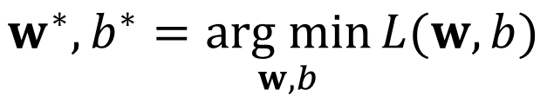
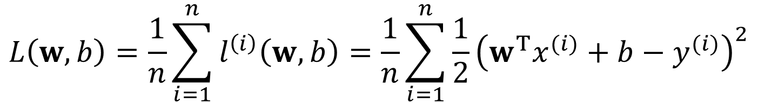


$$L\left(w,b\right)=\frac{1}{n}\sum_{i=1}^{n}{l^{\left(i\right)}\left(w,b\right)}=\frac{1}{n}\sum_{i=1}^{n}{\frac{1}{2}{\left(w^{T}x^{(i)}+b−y^{(i)}\right)}^{2}}$$
$$w^{∗},b^{∗}=\underset{w,b}{arg min}{L(w,b)}$$
$$∂_{w}{\left\|y−Xw\right\|}^{2}=2X^{T}(Xw−y)=0$$
$$X^{T}y=X^{T}Xw$$
$$w^{∗}={\left(X^{T}X\right)}^{−1}X^{T}y$$

Slide 22
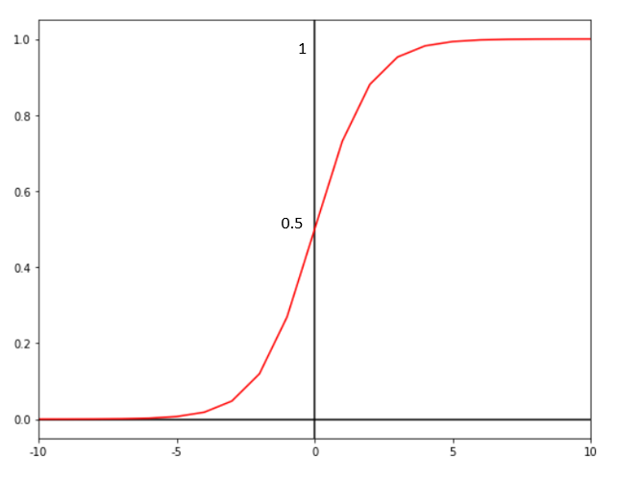
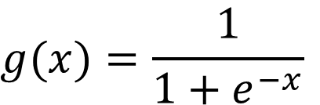
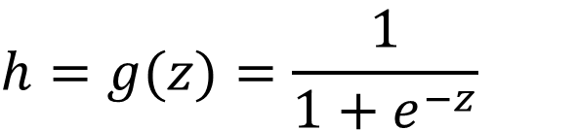
Logistic Regression 邏輯迴歸
Linear regression algorithms are used to predict/forecast values but logistic regression is used for classification tasks.
Logistic regression algorithm also uses a linear equation with independent predictors to predict a value. The predicted value can be anywhere between negative infinity to positive infinity.
We need the output of the algorithm to be class variable, i.e. 0-no, 1-yes. Therefore, we are squashing the output of the linear equation into a range of [0,1].
sigmoid function
$$z=θ_{0}+θ_{1}x_{1}+θ_{2}x_{2}+…$$
$$h=g(z)=\frac{1}{{1+e}^{−z}}$$
$$g(x)=\frac{1}{{1+e}^{−x}}$$

Slide 23
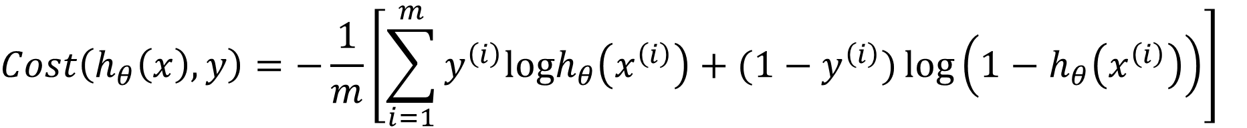
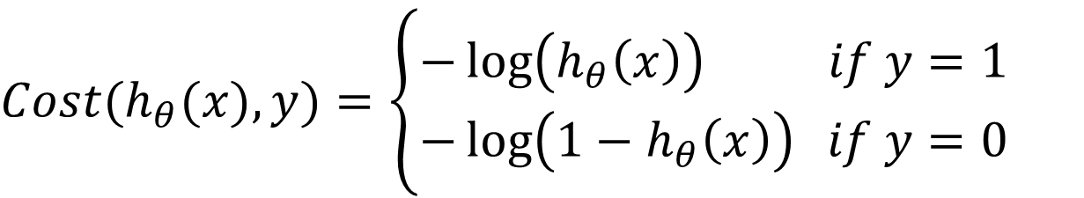
Cost Function
Since we are trying to predict class values, we cannot use the same cost function used in linear regression algorithm.
Use a logarithmic loss function to calculate the cost for misclassifying.
$$Cost(h_{θ}(x),y)=\left\{\begin{aligned}−\log\left(h_{θ}\left(x\right)\right) if y=1 \\ −\log\left(1−h_{θ}\left(x\right)\right) if y=0\end{aligned}\right.$$
$$Cost\left(h_{θ}\left(x\right),y\right)=−\frac{1}{m}\left[\sum_{i=1}^{m}{y^{\left(i\right)}logh_{θ}\left(x^{\left(i\right)}\right)+{(1−y}^{\left(i\right)})\log\left(1−h_{θ}\left(x^{\left(i\right)}\right)\right)}\right]$$

Slide 24
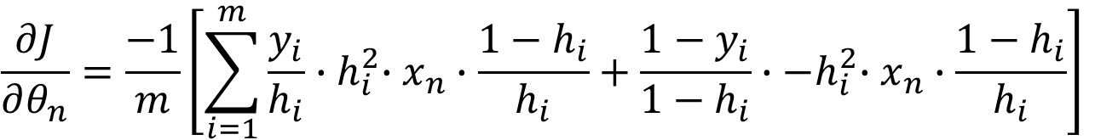
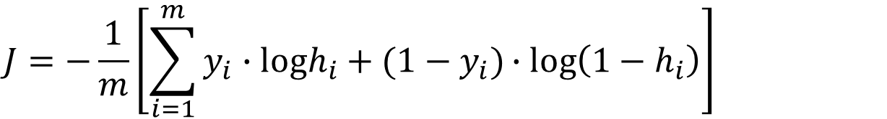
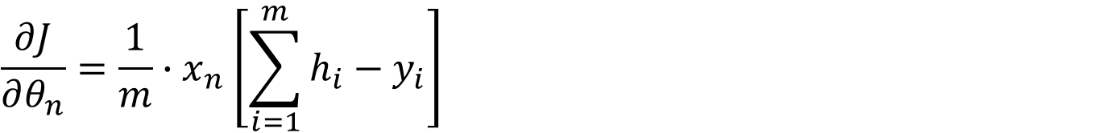
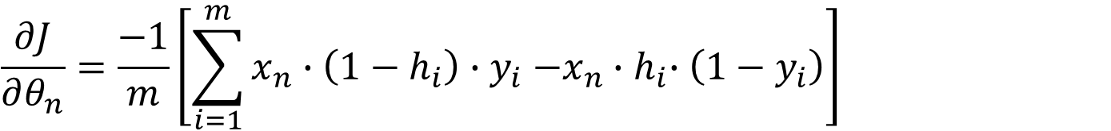
Calculate gradients
$$J=−\frac{1}{m}\left[\sum_{i=1}^{m}{y_{i}∙logh_{i}+(1−y_{i})∙log\left(1−h_{i}\right)}\right]$$
$$\frac{∂J}{∂θ_{n}}=\frac{−1}{m}\left[\sum_{i=1}^{m}{\frac{y_{i}}{h_{i}}{∙h}_{i}^{2}∙x_{n}∙\frac{{1−h}_{i}}{h_{i}}+\frac{1−y_{i}}{{1−h}_{i}}{∙−h}_{i}^{2}∙x_{n}∙\frac{{1−h}_{i}}{h_{i}}}\right]$$
$$\frac{∂J}{∂θ_{n}}=\frac{−1}{m}\left[\sum_{i=1}^{m}{x_{n}∙\left({1−h}_{i}\right){∙y}_{i}−x_{n}{∙h}_{i}∙\left({1−y}_{i}\right)}\right]$$
$$\frac{∂J}{∂θ_{n}}=\frac{1}{m}{∙x}_{n}\left[\sum_{i=1}^{m}{h_{i}−y_{i}}\right]$$

